Slide 1
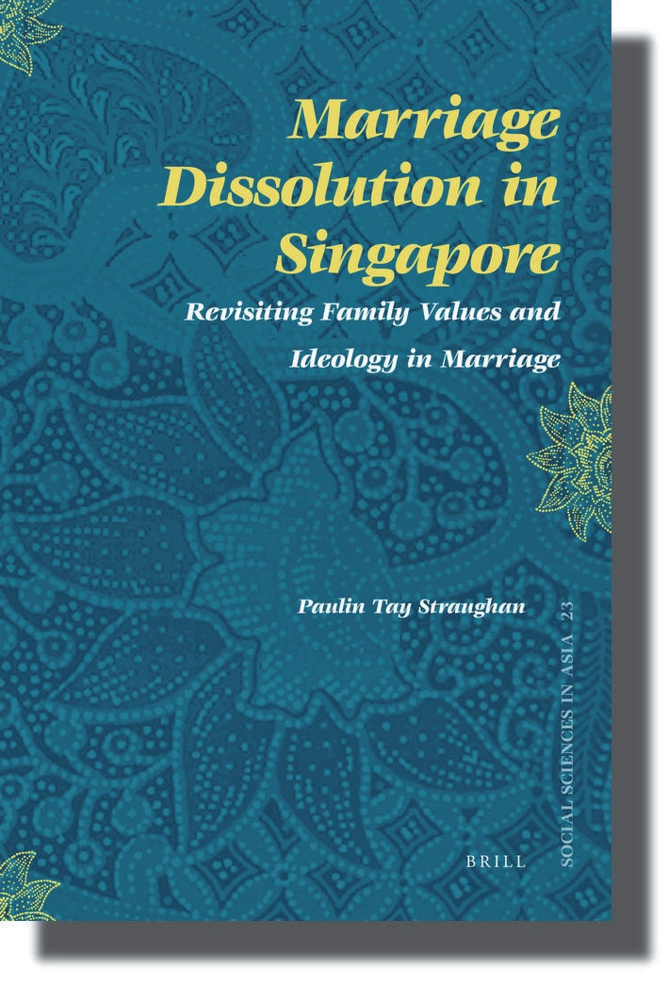
Highlights of Findings

Slide 2
The Divorce Project
Profile of divorcees from administrative data 1995-2000
Compare reasons from and attitudes towards marriage between divorced and married couples
Derive an understanding of the barriers and facilitators to divorce in Singapore

Slide 3
Methodology
Phase I – Trends from Administrative Data (July 2002)
Syariah Court 1995 – 2000
Civil Court 1995 – 2000
Phase II
Survey of recent divorces
Survey of married couples

Slide 4
Survey of Divorces 2000
Target population: marriages dissolved in 2000
Proportional stratified sample
→Syariah Court: 690 out of 1607
→Civil Court: 1057 out of 3336
Sampling unit: petitioner of divorce

Slide 5
Sampling the Control Group
Intact marriages as control group
Proportional stratified sample
→Syariah Court: 591
→Civil Court: 1321
Pilot tests Jan - Feb 2004
Field work March – May 2004

Slide 6
Response Rate
Response Rate | Married | % | Divorced | %
Civil Court | 652 | 51.4 | 519 | 54.2
Syariah Court | 374 | 67.0 | 308 | 56.2

Slide 7
The Sample
 |  | Divorced | Married
Gender | Male | 36.1% | 48.6%
 | Female | 63.9% | 51.3%
Ethnicity | Chinese | 58.6% | 60.6%
 | Indian | 5.9% | 4.6%
 | Malay | 31.9% | 33.2%
 | Other | 3.5% | 1.3%

Slide 8
The Sample
Divorced → HDB 4-room
Married → HDB 5-room and larger
Secondary school education
Median age
Divorced → 40 years
Married → 41 years
Age at marriage:
Divorced → 24 years
Married → 26 years

Slide 9
Key Findings
Courtship, Family Support, Marriage Preparation
Role of Ideology in Marriage & Divorce
Power of Paid Work
Parenthood
Conflict Management

Slide 10
Preparing for Long-term Commitment
Longer courtship → intact marriages
Motivations for marriage:
Romantic love – significance?
Start family
Family pressure
HDB
Notes:
Impt of courtship tied to motivations for marriage – romantic love needs to be cultivated over time

Slide 11
Marriage Preparation
Formal preparation → religious preparation* & non-religious preparation programs
Informal preparation → consult family members*, friends*
Positive correlation between marriage preparation & intact marriage – are you surprised? What does this tell you about the expectations of contemporary marriages?
Not so simple, as expectations are quite demanding
Notes:
Non-religious prep not quite established at time of survey

Slide 12
Specific Discussions on Marital Expectations
Life goals & priorities
Family planning
Marital expectations
Money matters
Marital roles & responsibilities
In-law issues
Sexual intimacy

Slide 13
Courtship & Marriage Preparation
Longer courtship → marriage preparation
Non-religious marriage preparation, consulting with family & friends
Talked about money matters, family panning,
marital roles/responsibilities, life goals/priorities, marital expectations, & in-law issues
Notes:
Shorten period of courtship is not good.

Slide 14
Role of Family in Marriage
Support from parents & in-laws sustains marriage
Contemporary marriage → union between 2 non-kin strangers
Why is family support still significant in a participant-run system?
Notes:
Sociological reason: notion of marriage, bringing an outsider to the insider side. If not accepted than more tensions.
In a geographically challenged Singapore, you meet people which will be either family members or will share information with the family members

Slide 15
Division of Domestic Labour
19 domestic responsibilities → homecare, childcare, eldercare, domestic supervision
Women do more than men
(self-responsibility 8.8 vs 2.7)

Slide 16
Division of Domestic Labour
Division of Domestic Labour | Status of Marriage | Mean
Self-Responsible | Divorced Married | 7.3 5.1
Spouse Responsible | Divorced Married | 2.9 4.4
Shared | Divorced Married | 3.3 5.2
Notes:
Shared - usually child related or elderly related

Slide 17
Division of Domestic Labour
Greater satisfaction with division → intact marriages
Significance of this finding?
- Why do women continue to do more at home?
Notes:
It’s not how much absolute equality that’s impt – it’s the perceived inequality that matters

Slide 18
Ideology as Policing Agent
Positive attitude towards marriage → intact marriages
Negative attitude towards divorce → intact marriages
Liberal gender ideology → positive towards divorce, negative towards marriage

Slide 19
Power of Paid Work
Spouses worked overtime → divorced
Unhappy with spouses’ work hours → divorced
Divorced more likely to perceive that spouses’ work patterns contributed to unhappiness in marriage

Slide 20
Power of Paid Work
Longer hours worked on Saturdays
Longer hours worked on Sundays
Spouses’ overseas business travels – frequency & duration
Alone on business travels
Unhappy with arrangements on whether companionship on business travels
Unhappy with spouses’ business travels
Notes:
You can’t be in two places at any one time!
Social construction of weekend as a family time. And people still work on Fridays and Saturdays.

Slide 21
Quality Couple Time
More time doing things together or just enjoying each others’ company
Talk to spouse about things important
Happy with amount of time spent with spouse
Notes:
Impt of communication – function of contemporary marriages which focus on romantic love and companionship

Slide 22
Parenthood
Presence of children as significant policing factor → no children more likely to be divorced
More children under 12 years, increase likelihood of intact marriage
Prepared for arrival of first child → more likely to be married

Slide 23
Conflict Management
Index of conflict management skills
Married → better cm skills
Married → spouse with better cm skills
What does this tell you about the expectations of modern marriages?
Notes:
Again, stress on impt of communication
Note for marriage prep programs

Slide 24
What Married People Want
20.2% attended marriage-related activities & programs
Attendees enjoyed higher marital satisfaction
Strong endorsement for relevance of marriage-enhancement programs in sustaining marriages
Notes:
Malays, younger and more traditional more likely to attend
Attendees enjoy higher marital satisfaction

Slide 25
Health of Marriages
90.4% of married respondents did not ever considered divorce
94.3% did not ever discuss intent to divorce with spouse
Most enjoyed consensus in decision-making

Slide 26
Reflections from Divorcees
Difficulties arose in the initial years
70.3% attributed poor communication for marital breakdown
While 33% cited adultery as reason for marital breakdown, it is ranked by majority as the most important reason for divorce
Merits of compulsory marriage preparation programs
Notes:
Adultery as straw that breaks camel’s back

